Slide 1

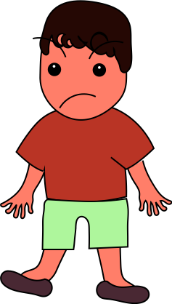
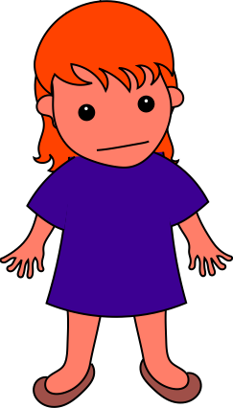
Drew kicked Carol.
Notes:
Joe wanted to learn Lucy's game. Joe said to Lucy, “Teach me how to play your game.”

Slide 2
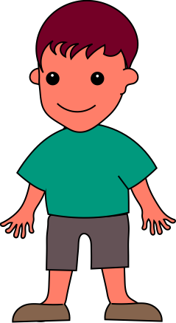

Graham gave Carol a gift.
Notes:
Sammy wanted to learn Lucy's game too. Sammy asked Lucy, “Can you teach me how to play your game?”

Slide 3
Remember, Drew kicked Carol. Graham gave her a gift. Which one was being meaner? Which one was being nicer?
Notes:
Which one was being nicer? Which one would you rather play with?

Slide 4
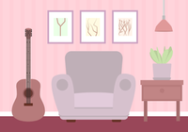
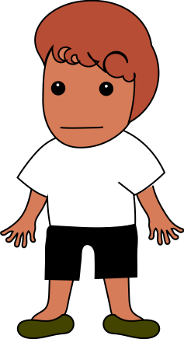
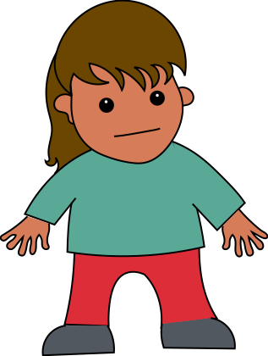

Anne was in a room where the lights were on. Greg doesn’t like bright lights, so he said, “please turn off the light.”
Notes:
Anne was in a room where the lights were on. Greg doesn’t like bright lights, so he said, “please turn off the light.”

Slide 5
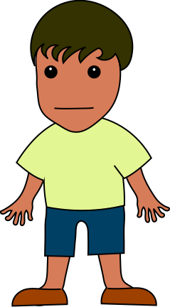
Bob also doesn’t like bright lights, so he said, ”Turn off the light.”
Notes:
Bob also doesn’t like bright lights, so he said, ”Turn off the light.”

Slide 6
Remember, Greg said: "please turn off the light." Bob said: "Turn off the light."
Which one was being more polite? Why? Which one would you rather play with? Why?
Notes:
Which one was being more polite? Which one would you rather play with?

Slide 7

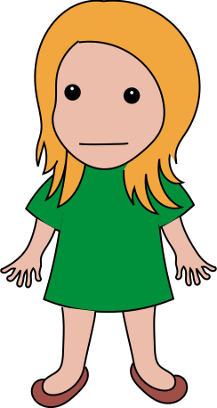
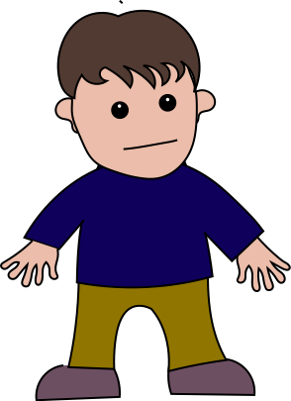


Jamie wanted more water in her cup. Jamie said to Fred, “Please pour me more water”
Notes:
Jean wanted more water in her cup. Jean said to Fred, “Please pour me more water”

Slide 8
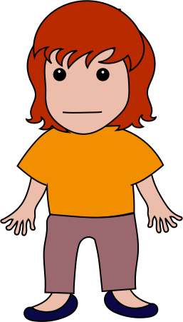
Suzy also wanted more water in her cup. Suzy said to Fred, ”Pour me more water.”
Notes:
Suzy also wanted more water in her cup. Suzy said to Fred, ”Pour me more water.”

Slide 9
Remember, Jamie said: "Please pour me more water." Suzy said: "Pour me more water."
Which one was being nicer? Which one will Fred give water to?
Notes:
Which one was being nicer? Which one would you rather play with?

Slide 10
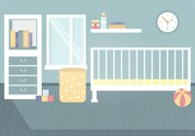
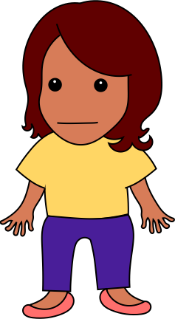
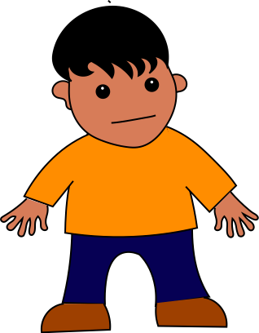


Millie thought Rick’s room was too messy. She told him, ”Pick up the toys.”
Notes:
Millie thought Rick’s room was too messy. She told him, ”Pick up the toys.”

Slide 11
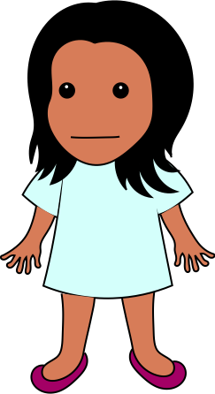
Franny also thought Rick’s room was too messy. She told him, “Can you pick up the toys?”
Notes:
Franny also thought Rick’s room was too messy. She told him, “Can you pick up the toys?”

Slide 12
Remember, Millie said: "Pick up the toys." Franny said: "Can you pick up the toys?"
Which one was being meaner? Which one would you rather play with?
Notes:
Which one was being nicer? Which one would you rather play with?

Slide 13
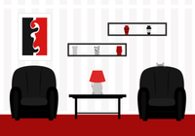
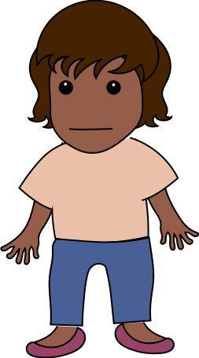
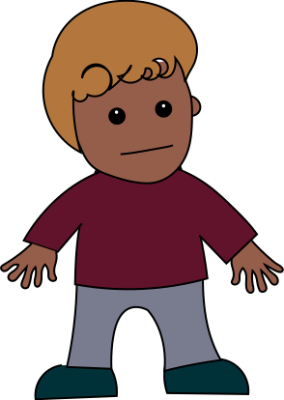
Carla wanted someone to go to the store with. Carla tells Simon, ”Come to the store with me.”
Notes:
Carla wanted someone to go to the store with. Carla tells Simon, ”Come to the store with me.”

Slide 14
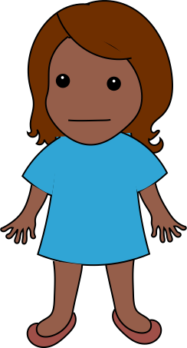
Ashley also wanted someone to go to the store with. Ashley tells Simon, “Can you please come to the store with me?”
Notes:
Ashley also wanted someone to go to the store with. Ashley tells Simon, “Can you please come to the store with me?”

Slide 15
Remember, Carla said: "Come to the store with me." Ashley said: "Can you please come to the store with me?"
Which one was being nicer? Which one will Simon go to the store with?
Notes:
Which one was being more polite? Which one would you rather play with?

Slide 16

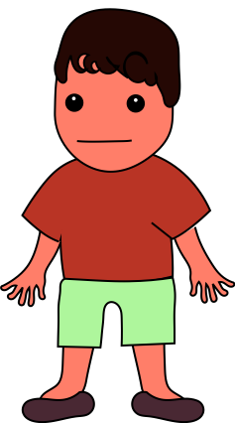

Tasha had a bar of chocolate. Louis said to Tasha, “Please give me some chocolate”
Notes:
Tasha had a bar of chocolate. Louis said to Tasha, “Please give me some chocolate”

Slide 17

Paul said to Tasha, “Give me some chocolate.”
Notes:
Tasha had another bar of chocolate. Paul said to Tasha, “Give me some chocolate.”

Slide 18
Remember, Louis said: "Please give me some chocolate." Paul said: "Give me some chocolate."
Which one was being meaner? Which one will Tasha give chocolate to?
Notes:
Which one was being nicer? Which one would you rather play with?

Slide 19
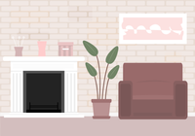


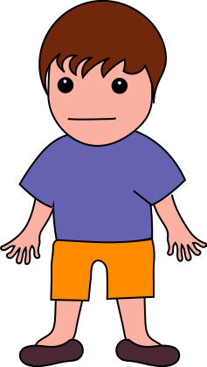
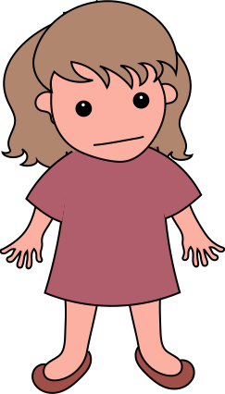

Josh didn’t like Kathy’s song. Josh said to her, ”Stop singing.”
Notes:
Josh didn’t like Kathy’s song. Josh said to her, ”Stop singing.”

Slide 20
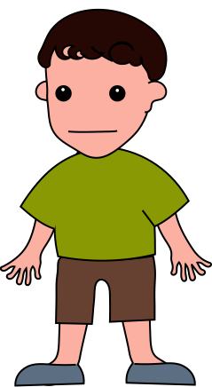
Andy didn’t like Kathy’s song either. Andy said to her, “Could you please stop singing?”
Notes:
Andy didn’t like Kathy’s song either. Andy said to her, “Could you please stop singing?”

Slide 21
Remember, Josh said: "Stop singing." Andy said: "Could you please stop singing?"
Which one was being more polite? Which one would you rather play with?
Notes:
Which one was being more polite? Which one would you rather play with?

Slide 22

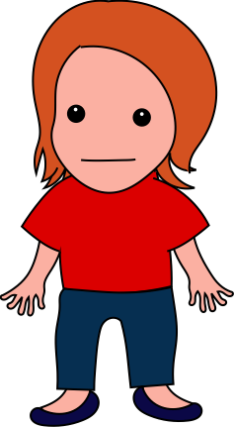
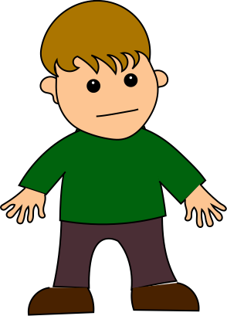
Tom was running inside the house. Marie said to him, ”Stop running inside.”
Notes:
Tom was running inside the house. Marie said to him, ”Stop running inside.”

Slide 23
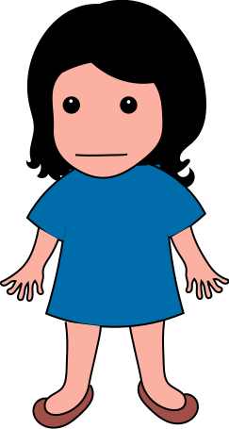
Tom was running inside the house again. Amy said to him, “Could you stop running inside?”
Notes:
Tom was running inside the house again. Amy said to him, “Could you stop running inside?”

Slide 24
Remember, Marie said: "Stop running inside." Amy said: "Could you stop running inside?"
Which one was being nicer? Which one would you rather play with?
Notes:
Which one was being more polite? Which one would you rather play with?

Slide 25

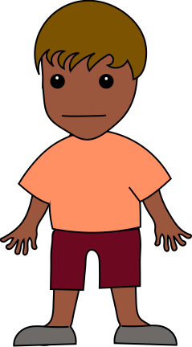
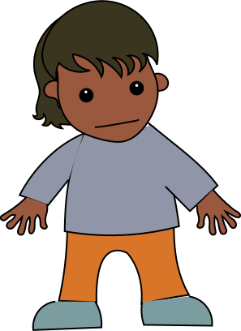

Claude was hungry, so Claude said to Alice, “Can you please give me more bread?”
Notes:
Claude was hungry, so Claude said to Alice, “Can you please give me more bread?”

Slide 26
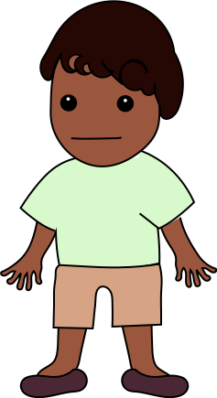
Ernie was hungry too, so Ernie said to Alice, ”Give me more bread.”
Notes:
Ernie was hungry too, so Ernie said to Alice, ”Give me more bread.”

Slide 27
Remember, Claude said: "Can you please give me more bread?" Ernie said: "Give me more bread."
Which one was being meaner? Which one would you rather play with?
Notes:
Which one was being nicer? Which one would you rather play with?

Slide 28


Jean wanted to use the scissors. Jean said to Chris, ”Hand me the scissors.”
Notes:
Jean wanted to use the scissors. Jean said to Chris, ”Hand me the scissors.”

Slide 29
Mia also wanted to use the scissors. Mia said to Chris, “Could you please hand me the scissors?”
Notes:
Mia also wanted to use the scissors. Mia said to Chris, “Could you please hand me the scissors?”

Slide 30
Remember, Jean said: "Hand me the scissors." Mia said: "Could you please hand me the scissors?"
Which one was being more rude? Which one will Chris give the scissors to?
Notes:
Which one was being nicer? Which one would you rather play with?

Slide 31


Scott needed help with his puzzle. Scott said to Kate, “Could you help me with this puzzle?”
Notes:
Scott needed help with his puzzle. Scott said to Kate, “Could you help me with this puzzle?”

Slide 32
Johnny also needed help with his puzzle. He said to Kate, “Help me with this puzzle”
Notes:
Johnny also needed help with his puzzle. He said to Kate, “Help me with this puzzle”

Slide 33
Remember, Scott said: "Could you help me with this puzzle?" Johnny said: "Help me with this puzzle."
Which one was being more polite? Which one will Kate help with the puzzle?
Notes:
Remember, Scott said: "Could you help me with this puzzle?" Johnny said: "Help me with this puzzle."
Which one was being more polite? Which one would you rather play with?

Slide 34

Jenny heard Miles shout. Jenny told him, “Please don't shout.”
Notes:
Jenny heard Miles shout. Jenny told him, “Please don't shout.”

Slide 35
Zoe also heard Miles shout. Zoe told him, ”Don’t shout.”
Notes:
Zoe also heard Miles shout. Zoe told him, ”Don’t shout.”

Slide 36
Remember, Jenny said: "Please don't shout." Zoe said: "Don't shout."
Which one was being more rude? Which one would you rather play with?
Notes:
Which one was being more polite? Which one would you rather play with?

Slide 37

Joe wanted to learn Lucy's game. Joe said to Lucy, “Teach me how to play your game.”
Notes:
Joe wanted to learn Lucy's game. Joe said to Lucy, “Teach me how to play your game.”

Slide 38
Sammy wanted to learn Lucy's game too. Sammy asked Lucy, “Can you teach me how to play your game?”
Notes:
Sammy wanted to learn Lucy's game too. Sammy asked Lucy, “Can you teach me how to play your game?”

Slide 39
Remember, Joe said: "Teach me how to play your game." Sammy said: "Can you teach me how to play your game?"
Which one was being more rude? Which one will Lucy teach about the game?
Notes:
Which one was being nicer? Which one would you rather play with?

Slide 40
What do you think it means to be polite?
What do you think a polite person does?

Slide 41
The End!

